Slide 1
Morning Check-In ✔
Write a function that takes in an integer and outputs the sum of all the numbers from 1 to that integer.
Ex: Input: 2 Output: 3 (because 1 + 2 = 3) Input: 4 Output: 10 (because 1 + 2 + 3 + 4 = 10) Input: 10 Output: 55
Hint - you might need to… iterate...

Slide 2
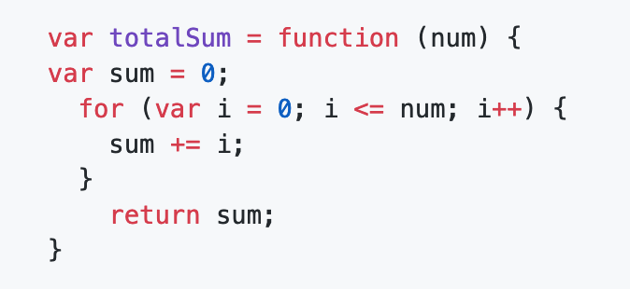
Morning Check-In ✔
Write a function that takes in an integer and outputs the sum of all the numbers from 1 to that integer.

Slide 3

Today’s Objectives
In today’s class we’ll be introducing:
Use the console to inspect the window object via this.
Use various web APIs to traverse the DOM.
Query the DOM for elements by their selector.
Use setAttribute() to add styles to specific elements.
Create an entire HTML page using only JavaScript.
Use timers/intervals to execute code based on some amount of time passing.

Slide 4
Lesson Learned

Slide 5
Variable Naming
Name your NOUNS
Use short enough and long enough variable names
Use specific names for variables
Use meaningful names for variables. Variable name must define the exact explanation of its content.
Obey programming language standards (CamelCase)
Don't use same variable for different purposes in a method, conditional etc. Create a new and different named variable instead.
Don't use too long variable names (e.g. 50 chars)

Slide 6
Function Naming
Name your VERBS
Use specific names for functions
Your function does something – the name should indicate what it does
Modularity: Your function should do ~One Thing
Example:
function resetGame(){
//resets game }

Slide 7
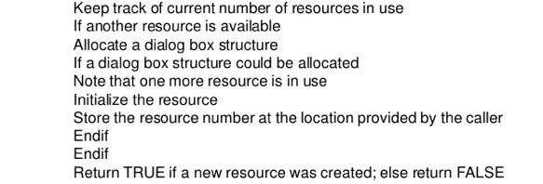
Pseudo Coding
Plan your Track/ Stay on Track a notation resembling a simplified programming language, used in program design.

Slide 8
Events and Event Handling

Slide 9
Window Object & Scope

Slide 10
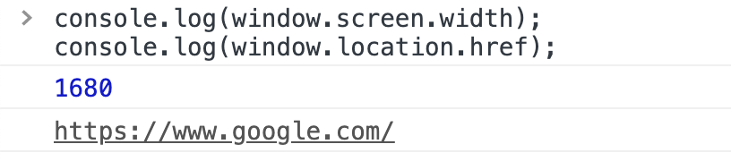
Window Object & Scope
objects are useful for storing related data and methods (or functions). We can make our own objects in JavaScript and access built-in objects. One such built-in object is the window object.
The alert method actually belongs to the window object, we just don't have to write window.alert() (even though that still works).
The window object contains a lot of other helpful information and methods for us to use, including the user's screen width and the URL they are currently visiting:
console.log(window.screen.width);
console.log(window.location.href);

Slide 11
Window Object & Scope
the window object is a global variable. A global variable is a variable that can be seen everywhere. Scroll down to the first function and point out that window is still available inside this function:
function firstFunction() {
console.log(window.screen.width);
}
firstFunction();
Adding a parameter to the function, which we named "window."
What will be console.logged here?
function secondFunction(window) {
console.log(window);
}
secondFunction("Hello");

Slide 12
Window Object & Scope
Adding a parameter to the function, which we named "window."
What will be console.logged here?
function secondFunction(window) {
console.log(window);
}
secondFunction("Hello");
Answer: Variables we create in a function take priority over global variables, if they have the same name. This is one rule of scope we should be aware of.

Slide 13
Window Object & Scope
var food = "Pizza";
var drink = "Water";
function thirdFunction(drink) {
console.log(food);
console.log(drink);
}
thirdFunction("Orange Juice");
variables food and drink are global variables, because we defined them outside of any functions. That means thirdFunction can access and console.log them.
What the line console.log(drink) will print?
Because we named our parameter the same name as a global variable, the parameter takes priority. Suggest that maybe we should use unique names to avoid this problem in the future.

Slide 14
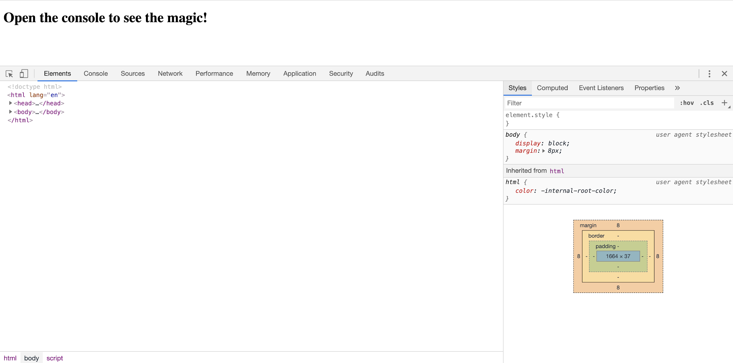
Window Object & Scope: 35-WindowObject

Slide 15
Mini-Project
36-LocationRedirect | 30 mins
From scratch, create a small application that will do two things:
Check which OS the user is on and alert a message that says, "Welcome, Windows user!" or, "Welcome, Mac user!"
Then check their geolocation and redirect them to a new page depending on if they are located on the east coast or west coast.
You'll need to do some research on how to gather some of this information, but here's a hint: it's going to be part of the window object we just looked at.

Slide 16
Mini-Project
36-LocationRedirect | 30 mins
From scratch, create a small application that will do two things:
Check which OS the user is on and alert a message that says, "Welcome, Windows user!" or, "Welcome, Mac user!"
Then check their geolocation and redirect them to a new page depending on if they are located on the east coast or west coast.
You'll need to do some research on how to gather some of this information, but here's a hint: it's going to be part of the window object we just looked at.
Hint: window.navigator, Window.location

Slide 17
Review Mini-Project
36-LocationRedirect
// See if user is on Windows
if (navigator.userAgent.indexOf("Windows") !== -1) {
alert ("Welcome, Windows user!");
getLocation();
}
// Then check for macOS
else if (navigator.userAgent.indexOf("Mac") !== -1) {
alert("Welcome, Mac user!");
getLocation();
}
// I give up
else {
alert("I don't know what you're using...");
}
we're using navigator.userAgent (or window.navigator.userAgent) to gather information about the user's machine and indexOf to check for OS-specific words.

Slide 18
Review Mini-Project
36-LocationRedirect
function getLocation() {
// Make sure browser supports this feature
if (navigator.geolocation) {
// Provide our showPosition() function to getCurrentPosition
navigator.geolocation.getCurrentPosition(showPosition);
}
else {
alert("Geolocation is not supported by this browser.");
}
}
If the user is on Windows or Mac, we'll call our getLocation() function
getCurrentPosition will call our showPosition function once it has data for us.

Slide 19
Review Mini-Project
Not every browser supports geolocation, so we first need to check if that property exists on navigator. If it does, then we can call the getCurrentPosition method. This is an interesting method, though, because the thing we're supposed to pass it is another function, which we've called showPosition.
getCurrentPosition will call our showPosition function once it has data for us.
we looked at window.location.href before when we wanted to get the current URL. But we can also use the same property to change the URL and take the user to another page or HTML document.
function showPosition(position) {
// Grab coordinates from the given object
var lat = position.coords.latitude;
var lon = position.coords.longitude;
console.log("Your coordinates are Latitude: " + lat + " Longitude " + lon);
// Call our next function, passing on the coordinates
redirect(lat, lon);
}
function redirect(lat, lon) {
// Compare latitude and longitude values
if (lat >= 30 && lon >= 90) {
// Redirect to a new page
window.location.href = "westcoast.html";
}
else {
window.location.href = "eastcoast.html";
}
}

Slide 20
Introduction to the DOM

Slide 21
What are the three building blocks of the web?

Slide 22



Building Blocks of the Web
HTML | CSS | JavaScript
Used to write content. | Used to format content. | Used to create dynamic web applications that take in user inputs, change what’s displayed to users, animate elements, and much more.

Slide 23
How (or where) do we connect all three?

Slide 24
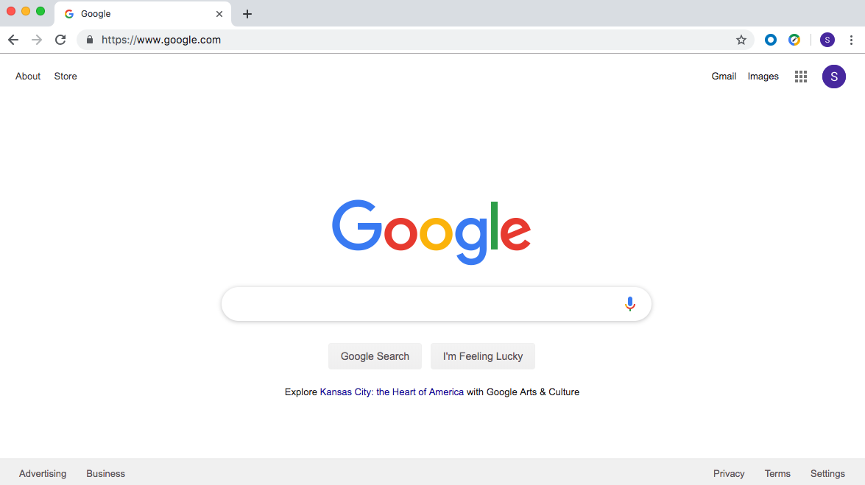
They Are Connected in the Web Browser
The browser brings together HTML, CSS, and JavaScript to create interactive webpages and applications.

Slide 25
What is a web browser?

Slide 26

A web browser, or browser, is a program used to access information on the World Wide Web. Every webpage, image, and video on the web can be accessed via a specific Unified Resource Link (URL). This lets browsers retrieve these resources from a web server and display them on a user's device.

Slide 27
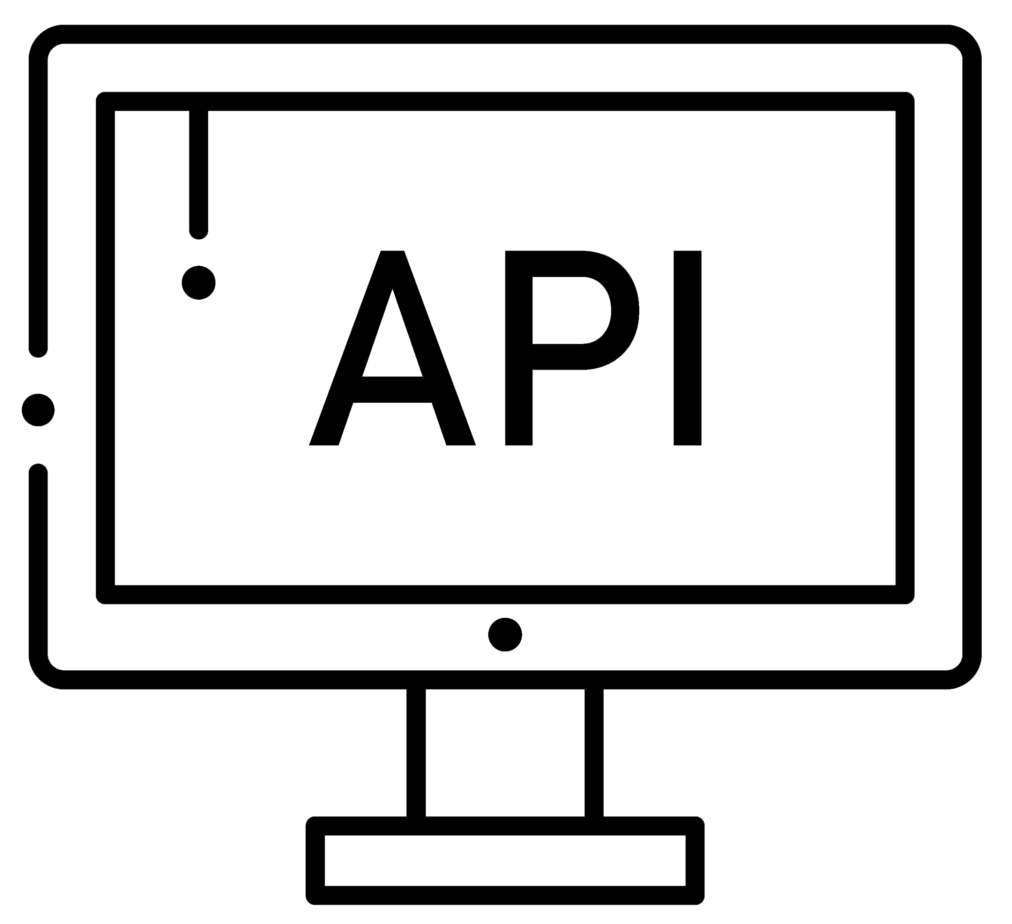
What is an application programming interface (API)?

Slide 28
In web development, an API is a set of code features (methods, properties, events, and URLs) that developers can use in their apps to interact with components of a user's web browser, data sets, hardware/software on a user’s computer, or third-party software and services.

Slide 29
What are web APIs?

Slide 30

Web APIs
Web APIs are built into the web browser and contain methods that allow us to manipulate a webpage using JavaScript.
We can use web APIs to create elements and add them to the browser or to add and remove styles and attributes—all via JavaScript!

Slide 31
Activity: This Window
See instructions in 01-Stu_This-Window in the class repo.
In this activity, you will use console.log(this) and dig around inside the returned object, answering some questions along the way.
10 minutes

Slide 32
Activity: This Window : 01-Stu_This-Window | 10 mins
Instructions
First open the provided index.html file in the browser and navigate to the console.
console.log(this); or console.log(window);
What is logged?
The window object. In this use case, this refers to the window. The window is an object representation of an open window in a browser.
Click in the window object and begin looking at the numerous properties and methods it contains.
Make your way down to document and click in it.
Spend some time looking through the properties and methods in window.document.

Slide 33
What is window.document?

Slide 34

The Document Object Model (DOM)
The DOM is an object-oriented representation of HTML (i.e., the HTML document modeled as JavaScript objects).
Each element is a node.
Nodes are organized in a tree.
Notes:
The DOM represents the document so that its structure, style, and content can be changed via interaction with JavaScript. The DOM represents the document as objects and nodes. This representation allows for programmers to access the web API and modify the DOM.
When an HTML file is opened in a browser, the browser creates an object to represent the document and all of its containing elements.
With our HTML represented as objects, we can add, change or remove elements using JavaScript.
Each HTML element is referred to as a node.
The nodes are organized in a tree structure similar to the parent-child relationship of nested HTML elements.

Slide 35
What Is the Node Tree of This HTML?
<!DOCTYPE html>
<html lang="en">
<head>
<title>Document</title>
</head>
<body>
<div>Main div
<article>
<section>
</section>
</article>
</div>
<div>
<a href="myImg"></a>
<a href="secondImg"></a>
</div>
</body>
</html>
Notes:
<!DOCTYPE html>
<html lang="en">
<head>
<title>Document</title>
</head>
<body>
<div>Main div
<article>
<section>
</section>
</article>
</div>
<div>
<a href="myImg"></a>
<a href="secondImg"></a>
</div>
</body>
</html>

Slide 36
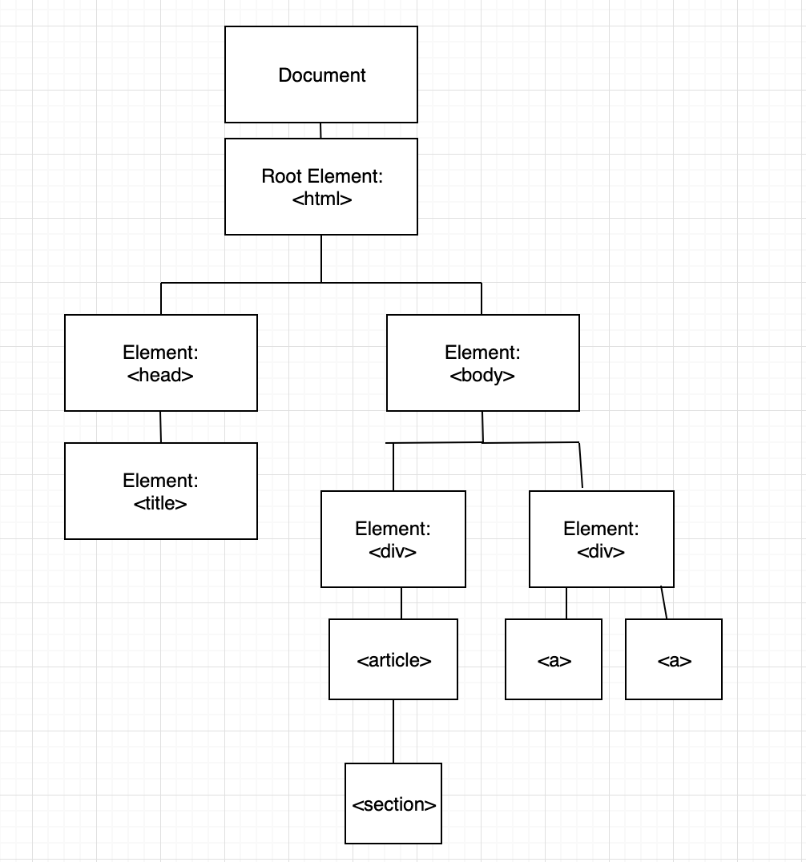
What Are the Parent, Child, and Sibling Nodes?

Slide 37
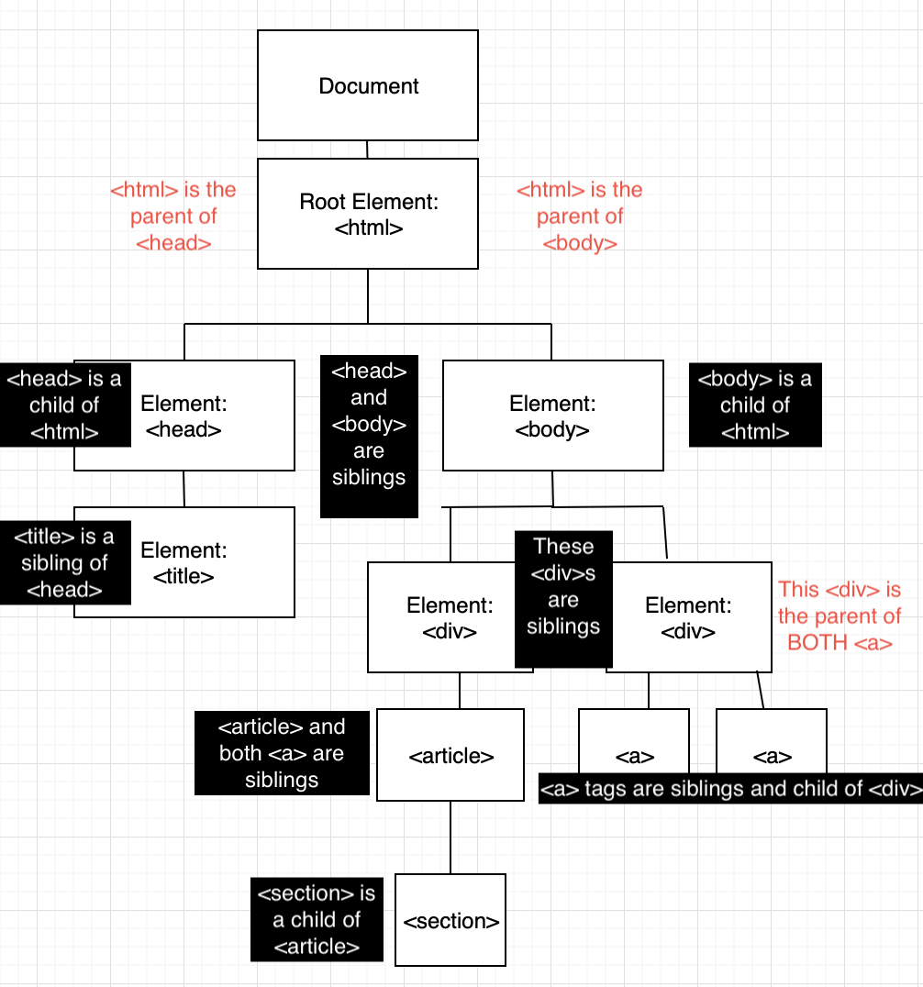
Node Relationships: Parents, Children, and Siblings

Slide 38
What is traversing the DOM?

Slide 39
First…..How do we?
var baby = {
name: "Asher",
age: 1,
"is cute": true,
isLoud: true,
toys: ["truck", "ball", "Mr. Squiggles"],
books: ["Pout Pout Fish", "The Adventures of John Muir", "The feelings Book"]
}
Access Pout Pout Fish ?

Slide 40
First…..How do we?
var baby = {
name: "Asher",
age: 1,
"is cute": true,
isLoud: true,
toys: ["truck", "ball", "Mr. Squiggles"],
books: ["Pout Pout Fish", "The Adventures of John Muir", "The feelings Book"]
}
Access Pout Pout Fish ?
Baby.books[1]
What does baby.toys[3] return?

Slide 41
First…..How do we?
var baby = {
name: "Asher",
age: 1,
"is cute": true,
isLoud: true,
toys: ["truck", "ball", "Mr. Squiggles"],
books: ["Pout Pout Fish", "The Adventures of John Muir", "The feelings Book"]
}
Modify an existing key value pair?
Add a new key value pair?

Slide 42
First…..How do we?
var baby = {
name: "Asher",
age: 1,
"is cute": true,
isLoud: true,
toys: ["truck", "ball", "Mr. Squiggles"],
books: ["Pout Pout Fish", "The Adventures of John Muir", "The feelings Book"]
}
baby.age += 1
baby.toys.push(“car car”);
baby.nickName = “Beelzebub”;

Slide 43

DOM Traversal : 02-Traverse-DOM
Navigate to the MDN DOM Docs. Open the Chrome Dev Tools and enter the following commands one by one.
console.log(document.body);
console.log(document.body.children);
console.log(document.body.children[3]);
console.log(document.body.children[1].childNodes[3].childNodes[1])........
When using the style method, properties with two words (such as font-size) become a single word and camelCased. font-size becomes fontSize.
.....style.color = "red";
console.log(document.body.children[1].childNodes[3].childNodes[1].style.color = "red")

Slide 44
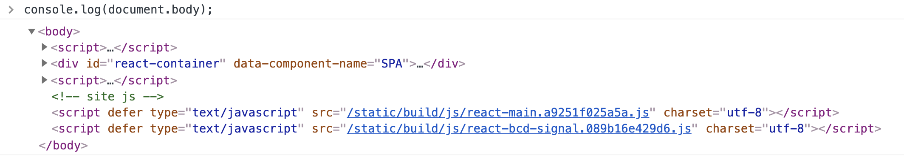
DOM Traversal: 02-Traverse-DOM
Navigate to the MDN DOM Docs. Open the Chrome Dev Tools and enter the following commands one by one.
console.log(document.body);

Slide 45
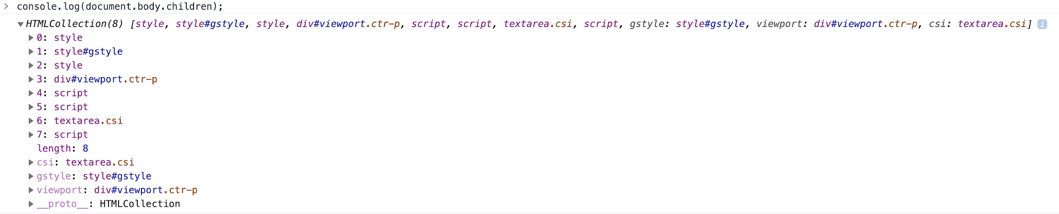
DOM Traversal: 02-Traverse-DOM
Navigate to the MDN DOM Docs. Open the Chrome Dev Tools and enter the following commands one by one.
console.log(document.body.children);
console.log(document.body.children[3]);

Slide 46
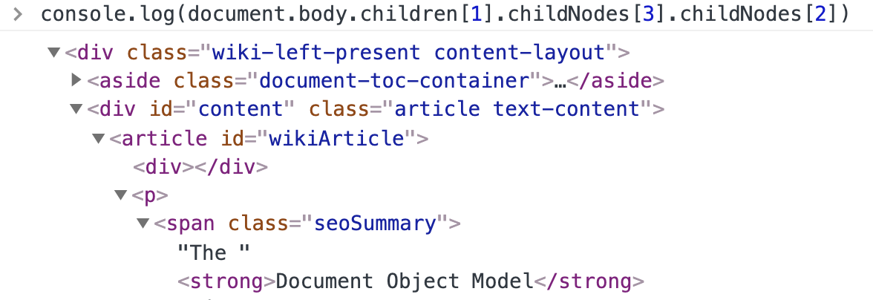
DOM Traversal: 02-Traverse-DOM
Navigate to the MDN DOM Docs. Open the Chrome Dev Tools and enter the following commands one by one.
console.log(document.body.children[1].childNodes[3].childNodes[2]);

Slide 47

Our Goal
Navigate to the deployed Speed Reader app.
What do you not (yet!) know about how to build this application?
What do you think the steps are to build this application?

Slide 48
Students Do: Stu_Traverse-That-DOM
03-Stu_Traverse-That-DOM | 10 mins
In this activity you are going to use the Chrome Dev Console and `.style.property` to change the styling of elements on our page.
Instructions
* Create a `script`
* Using the provided `index.html`, complete the following
* Target the div with the ID of `articles`.
* Change its font size to `50px`.
* Change its first childs, last child to have a font color of `blue`.
* Change its previous sibling to have a background color of `black`.
* Target the div with the ID of `main`.
* Change its second child node so the text is `underlined`.
* Change its last child element to have a font size of `50px`.
* Change its first child element to have a font color of `orange`.
* Change its last child elements parent to have a font size of `40px`.
Bonus
* Change 3 other elements styles that we did not ask for above.
Hints: document.getElementById, .style.color, .style.fontSize, etc

Slide 49
Review: Stu_Traverse-That-DOM
03-Stu_Traverse-That-DOM
We first gather our two main divs into variables for easy access.
var artDiv = document.getElementById("articles");
var mainDiv = document.getElementById("main");
What do the following lines do?
artDiv.children[0].lastElementChild.style.color = "white";
artDiv.children[0].style.fontSize = "50px";
artDiv.previousElementSibling.style.background = "black";
mainDiv.childNodes[1].style.textDecoration = "underline";
mainDiv.lastElementChild.style.fontSize = "50px";
mainDiv.firstElementChild.style.color = "white";
Q: What other properties or attributes can be set using JS?.
A: We can change any attribute or property using only JavaScript.

Slide 50
Setting Attributes | 04-Ins_Setting-Attributes
We can traverse the DOM and set styles via the .style method, now we are going to learn about .setAttribute.
setAttribute is a DOM method that allows us to add any attribute to an element. We can use it to add styles, hrefs, img srcs, and any other attribute you would like to add.
If the attribute already exists, the value will be updated. If there is no attribute, a new attribute is added with the specified name and value.
Let’s Uncomment our script.js
(have a look)

Slide 51
Students Do: Stu_Setting-Attributes
05-Stu_Setting-Attributes | 10 mins
Setting Attributes
In this activity you are going to use JavaScript to add `hrefs` to `a` tags, `src` to `img` tags, along with some styles all while traversing the DOM.
Instructions
* Open `index.html` and familiarize yourself with the structure of the HTML.
* Inside of your provided `script` complete the following:
* Give a `src` and `alt` attribute to the 3 provided `img` tags.
* Give a `href` attribute to the 3 provided `a` tags.`
* Add styles via `setAttribute` to make the page look decent. Recommended: margins and padding.
Hint: You may need a for loop!

Slide 52
Review | Stu_Setting-Attributes
We first gather all of our elements we would like to target.
var main = document.getElementById("main");
var sitesEl = document.querySelectorAll("sites");
var site1El = document.querySelector(".site1");
var site2El = document.querySelector(".site2");
var site3El = document.querySelector(".site3");
var siteTitles = document.querySelectorAll("h4");
We can then use the array returned by .children to navigate and setAttributes to elements.
site1El.children[1].setAttribute("href", "https://google.com");
Whenever we use setAttribute it takes two arguments. The first being the name of the attribute and the second its value.
site1El.children[1].children[0].setAttribute("src", "http://placekitten.com/200/200");
site1El.children[1].children[0].setAttribute("style", "padding:10px;");

Slide 53

It’s Lunch Time!
Return @ XX:XX

Slide 54
Events and Event Handling

Slide 55
Create and Append | 06-Ins_Create-Append
It will ask for a tag to create using prompts, and append the given element to the page.
If a proper tag name is not given it will let the user know and not create the element.
This is done using the DOM methods .createElement and .appendChild.
When using .createElement we pass in the name of the tag we would like to create and store it as a variable so we can later add it to the DOM.
var newDiv = document.createElement("div");
For us to show our newly created div on the page, we need to append it to the DOM via an existing element.
document.body.appendChild(newDiv);
The above code would append newDiv to the body as a child element.

Slide 56
Students Do: 07-Stu_LookMaNoHTML
07-Stu_LookMaNoHTML | 20 mins
In this activity you are going to use DOM methods to create an entire HTML page.
Instructions
* You have been provided a standard HTML document.
* You may only work inside your `script`.
* Inside `script` and using only DOM methods, create an entire HTML page. It should include:
* A centered h1 with a centered h2 under it.
* A centered image, with a center caption under it.
* A list of your favorite foods (or some other list of favorites).
* Some extra styling to all elements.

Slide 57
Review: 07-Stu_LookMaNoHTML
The first portion contains all of our references to existing elements, as well as all of our .createElement calls.
The next portion sets all of the textContent of our created elements.
Next we begin the process of appending all of our created elements with the newly modified text content.
Finally we go through all of our elements and use .setAttribute to change the styles and set image sources.

Slide 58
Timers and Intervals
Where are timers used in applications?
Countdowns
Calendars
Games
setTimeout and setInterval are two methods that allow for us to execute code based on time.
These two methods are actually above the document object and are attached directly to the window.
When using either of these timer methods, The first parameter is a function to be executed. The second parameter indicates the amount of time in milliseconds before execution.
setTimeout will execute the body of the function one time, once the allotted amount of time has passed.
setInterval will execute the body of the function every X amount of milliseconds as specified in the second argument to the setInterval function.
if we do not clearInterval, the interval would continue to run indefinitely. We stored our setInterval function in a variable so we could pass that instance into our clearInterval, stopping execution.
setTimeout has its own method for stopping execution, clearTimeout.

Slide 59
Students Do: 09-Stu_SpeedReader
09-Stu_SpeedReader | 30 mins
In this activity you are going to create a speed reading application. It will input a single word on the screen at a time, changing to the next word after 1 second. This equates to reading at 60 Words Per Minute (WPM).
Instructions
* The app should countdown from 5, and when the countdown is finished it should print one word to the screen every second. Each word replaces the other.
* Open `index.html` and create the necessary HTML. You will need at least 3 elements.
* Open `script`.
* The two function names have been created for you, as well as a poem to speed read.
* Fill out the necessary code that would create a countdown timer. When that timer completes, it should disappear and speed reading should begin.

Slide 60
Review: 09-Stu_SpeedReader
In our prepareRead function we store our interval in a variable so we can clear it later.
var timeInterval = setInterval(function() {
When the timer has run out, we empty the textContent of the timerEl and then execute our speedRead function.
if (timeLeft === 0) {
timerEl.textContent = " ";
speedRead();
clearInterval(timeInterval);
}
We used a prompt to ask the user to enter the speed at which they would like to read, we passed that response in as the second argument of our speedRead setInterval.
}, speed);
As opposed to a fixed value, i.e.,
}, 1000);
In the beginning of our speedRead function we append our bodyEl, generated via createElement, to the mainEl of our HTML page.
mainEl.append(bodyEl);
We use an if statement to check whether the piece we are reading is over. When words[i] begins to evaluate to undefined and not a word, we terminate the interval via clearInterval. As long as words[i] evaluates to a word from our array, we make the content of our mainEl reflect that.
if (words[i] === undefined) {
clearInterval(poemInterval);
} else {
mainEl.textContent = words[i];
i++;
}

Slide 61
Events and Event Handling…
To be Continued

Slide 62
Homework Intro

